Slide 1

Maximizing Fitness: How Different Exercises Impact Calorie Burn
This project analyzes calorie burned across various physical activities, helping individuals understand how different exercises impact calories burn based on their body weight and between type of exercises. Through data-driven insights, visualizations, and statistical analysis, we explore the most and least effective workouts for calorie consumption.

Slide 2
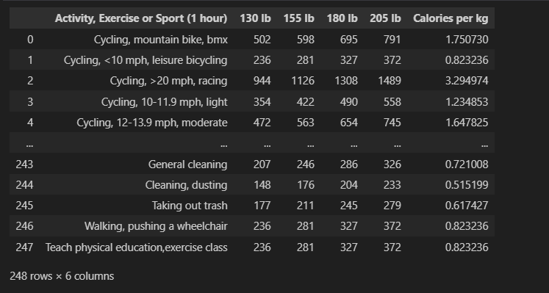
This table presents various exercises along with calories burned across different weight categories. It helps identify which activities are most efficient for calorie burn based on body weight.

Slide 3
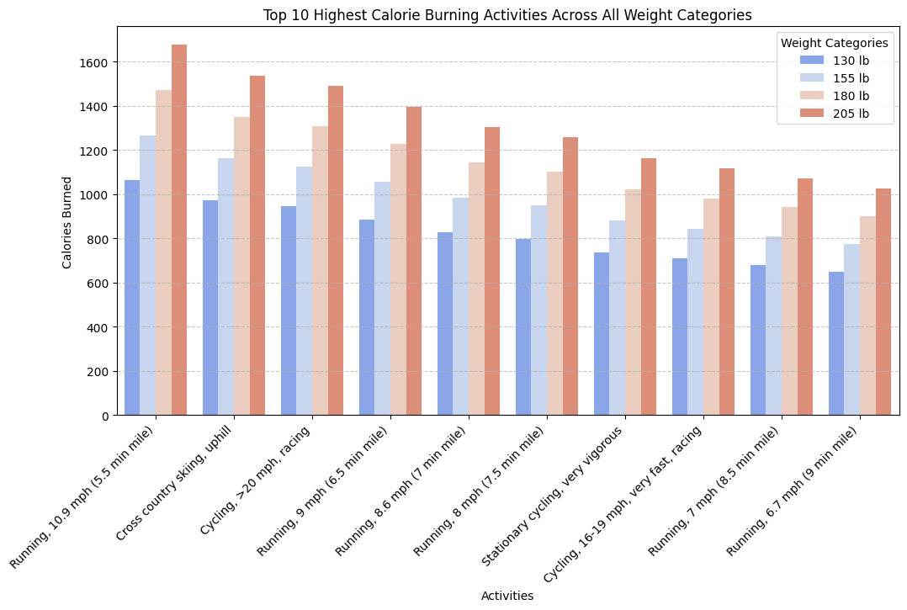
Top 10 Highest Calories Burning Activities Across All Weight Categories
"This chart displays the top 10 highest calorie-burning activities across different weight categories. Heavier individuals burn more calories, with running at high speeds, cycling, and cross-country skiing being the most intense activities.“
✅ Key Takeaways:
🔥 Running, Cycling, and Cross-Country Skiing burn the most calories.
⚖️ Heavier individuals burn more calories across all activities.
📊 Higher speed & intensity = higher calorie burn.

Slide 4
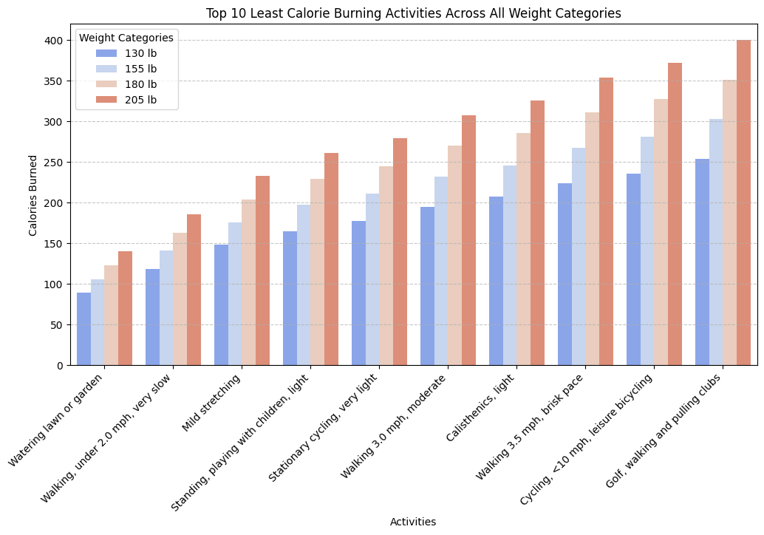
Top 10 Least Calories Burning Activities Across All Weight Categories
"This chart displays the top 10 least calorie-burning activities across different weight categories. Activities such as gardening, slow walking, mild stretching, and standing burn the fewest calories, with heavier individuals still burning slightly more than lighter individuals.“
✅ Key Takeaways:
❄️ Lowest Calorie Burners:
🧘 Mild Stretching
🚶 Walking (Under 2 mph, Very Slow)
🏠 Household Chores (Cleaning, Taking Out Trash)
🏋️ Low-Intensity, But Still Beneficial:
🔄 Improves flexibility & mobility
❤️ Good for active recovery & stress relief

Slide 5
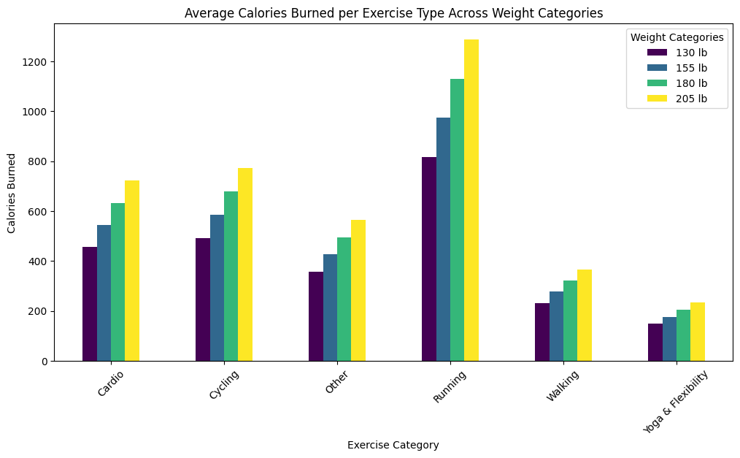
Average Calories Burned per Exercise Type Across Weight Categories
"This chart illustrates the average calories burned per exercise type across different weight categories. Running burns the most calories, followed by cardio and cycling. Heavier individuals burn more calories across all exercise types."

Slide 6
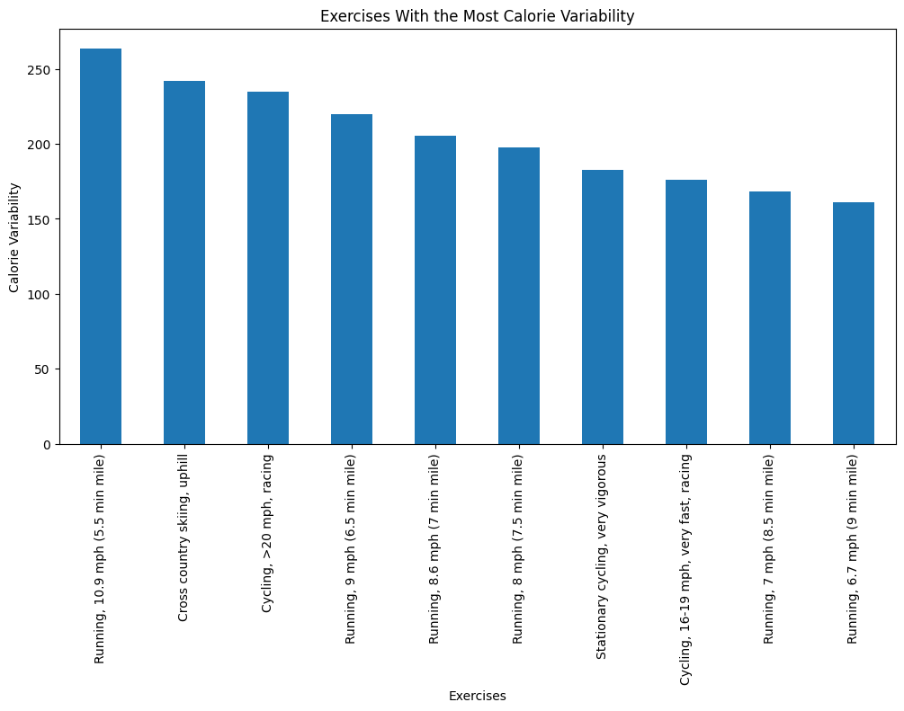
Exercises with the most calories Variability
Calorie variability refers to how much the calorie burn fluctuates across different weight categories for a particular exercise. It is a measure of how consistently an exercise burns calories across different body weights.
High Variability:
Exercises with high variability show large differences in calorie burn depending on a person's weight.
Example: Running at 10.9 mph
A person weighing 130 lbs burns 1062 calories, while a 205 lbs person burns 1675 calories (huge difference).
These exercises are highly weight-dependent.

Slide 7
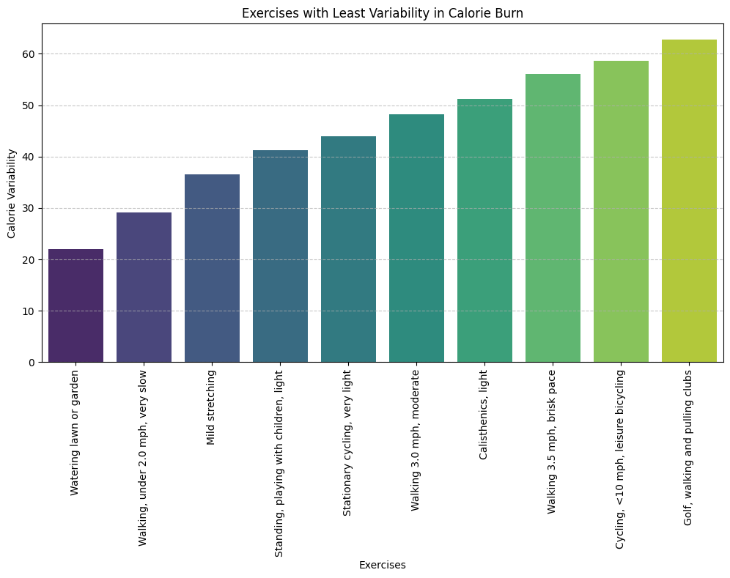
Exercise with Least Variability in Calories Burn
Low Variability:
Exercises with low variability have small differences in calorie burn across different weight categories.
Example: Mild Stretching
A person weighing 130 lbs burns 148 calories, while a 205 lbs person burns 233 calories (small difference).
These exercises burn calories at a steady rate regardless of weight.

Slide 8
Conclusion:
This analysis highlights how different exercises impact calorie burn based on body weight and intensity. High-intensity workouts (e.g., running, cycling, stair climbing) burn the most calories, while low-intensity exercises (e.g., walking, stretching) remain consistent across weights.
🔹 For Weight Loss: Running, High-Speed Cycling, Jump Rope 🔹 For General Fitness: Walking, Yoga, Pilates 🔹 For Strength & Endurance: Weight Training, Sports
Understanding exercise efficiency & variability helps individuals tailor workouts to their fitness goals—whether for weight loss, endurance, or strength. Choose smart, train efficiently, and maximize your fitness journey! 🚀💪

